Slide 1
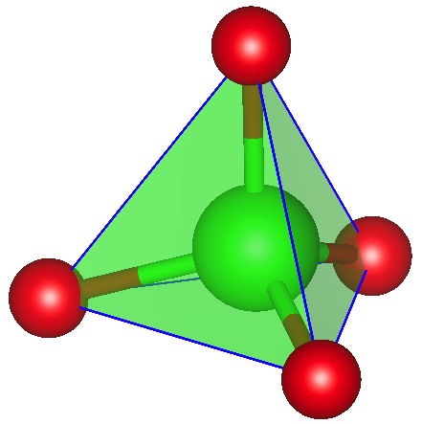
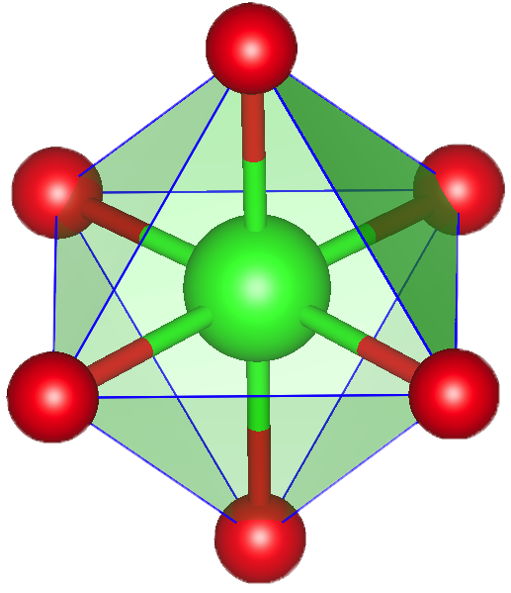
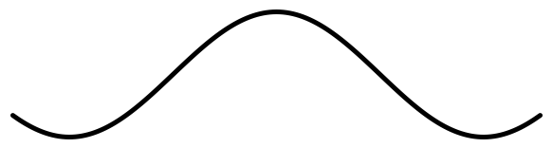
electronegativity difference
A ion diffusion
A
B
C
B
A
C
A
B
C
C
B
A

